Slide 1
CS5590 Applied Programming Series
Web/Cloud/Mobile Programming

Slide 2
NodeJS and MongoDB
Installation for Node JS, MongoDB and Creating Account and Database in MongoDB

Slide 3
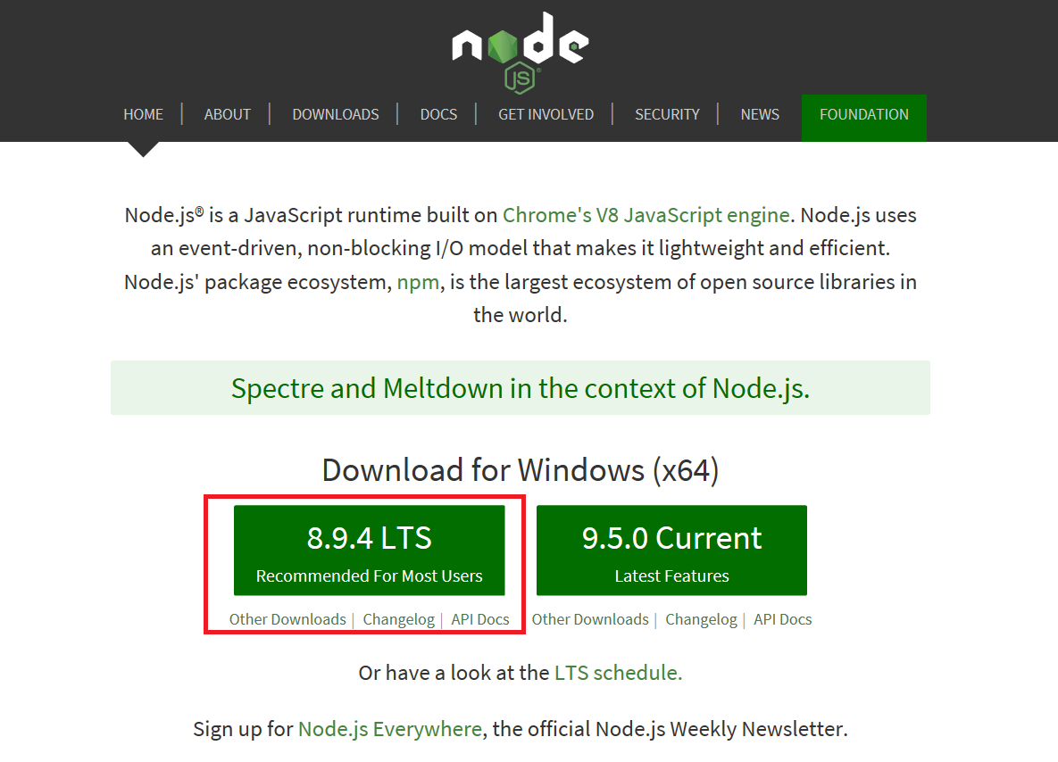
Node JS Installation
https://nodejs.org/en/

Slide 4
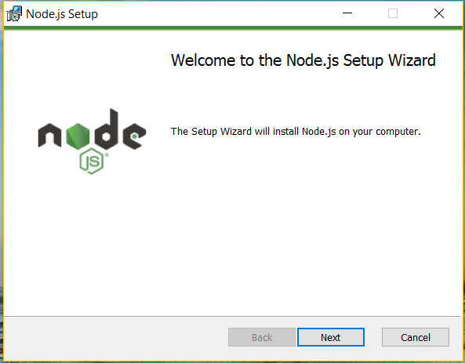
Node JS Installation
Follow the installation wizard which will install the Node JS successfully on your computer

Slide 5
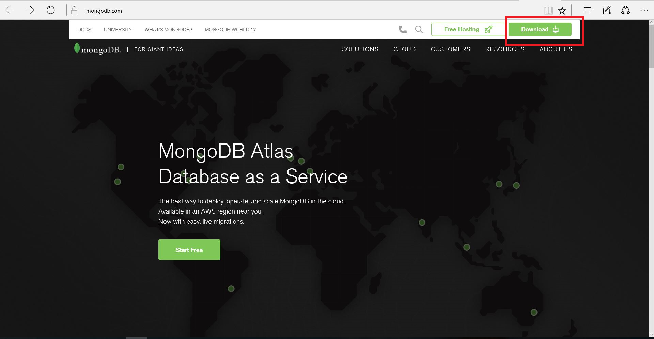
MongoDB Installation
https://www.mongodb.com/

Slide 6
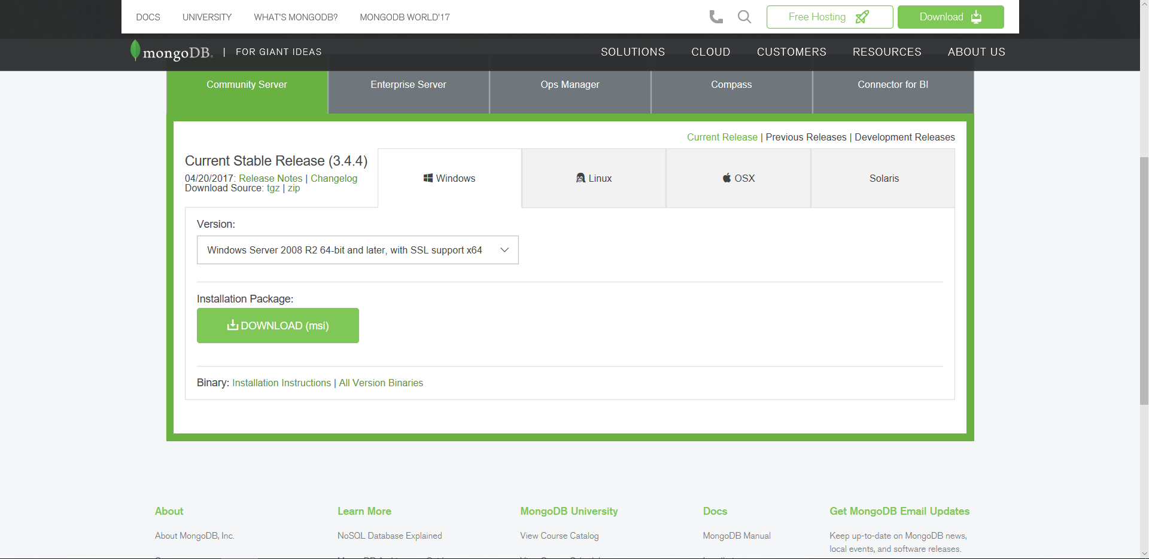
MongoDB Installation

Slide 7
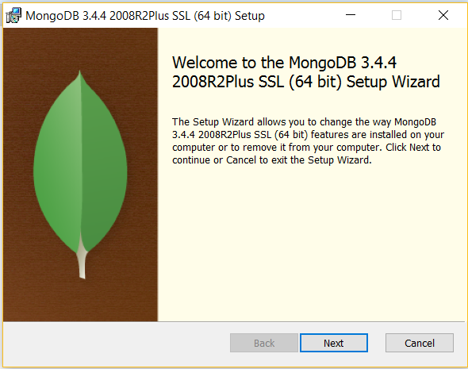
MongoDB Installation
Follow the installation wizard which will install the Mongo Db successfully on your computer

Slide 8
MongoDB Installation
On successful installation of the mongo database we have to set the Mongo installation path “C:\Program Files\MongoDB\Server\3.4\bin” under the System Path variables so as to get the mongo commands recognized. Follow the below steps.
1. From the Desktop, right-click the very bottom left corner of the screen to get the Power User Task Menu.
2. From the Power User Task Menu, click “System”.
3. Click the “Advanced System Settings” link in the left column.
4. In the “System Properties” window, click on the “Advanced” tab, then click the “Environment Variables” button near the bottom of that tab.

Slide 9
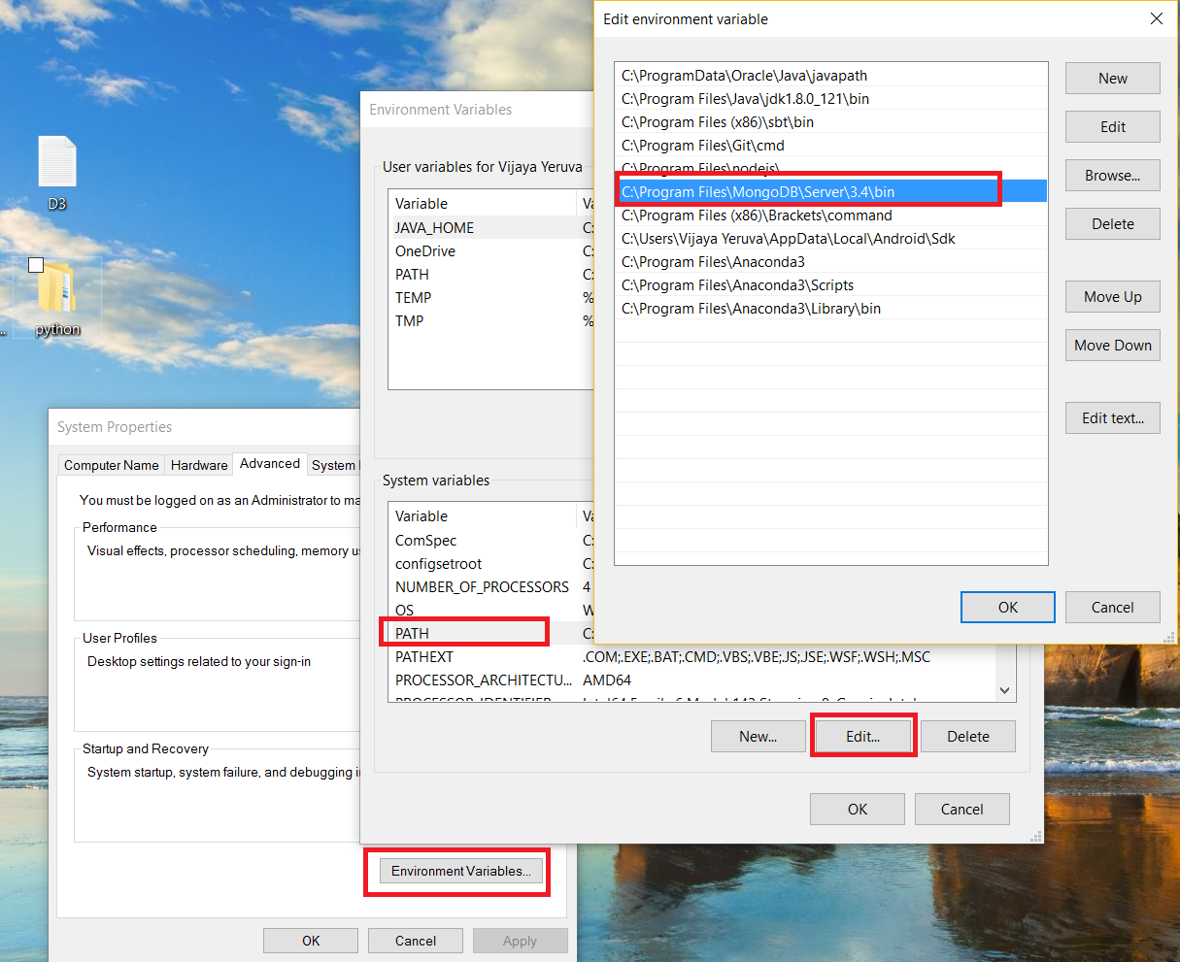
MongoDB Installation
5. In the Environment Variables window (pictured below), highlight the Path variable in the "System variables" section and click the Edit button. Add or modify the path lines with the paths you want the computer to access.

Slide 10
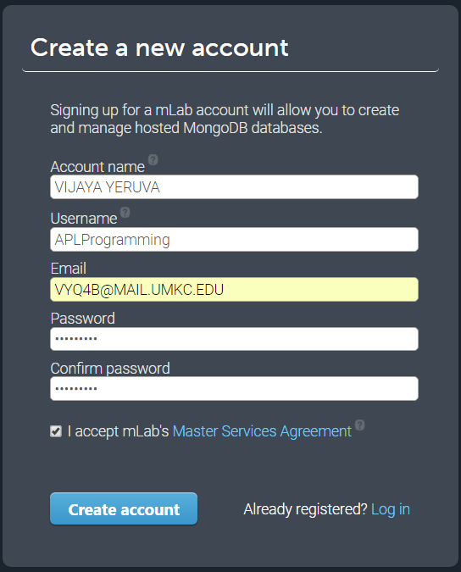
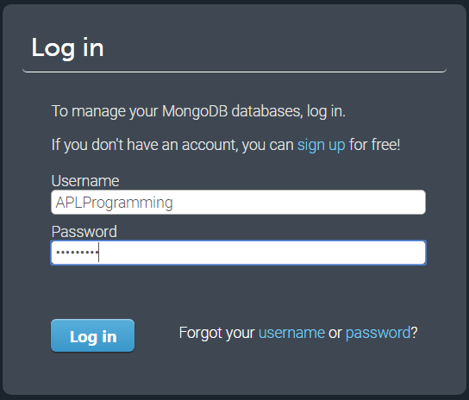
Mongo Lab - Account creation
https://mlab.com/welcome/

Slide 11
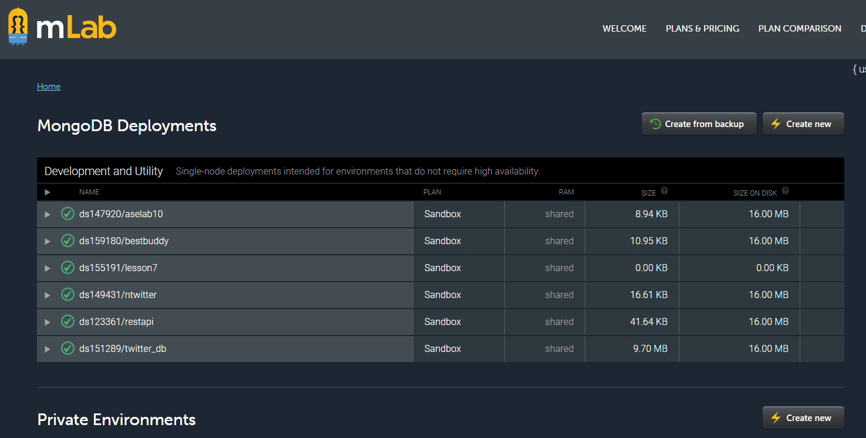
Mongo Lab - Account creation

Slide 12
Mongo Lab – Data Base creation
Click on “Create New” button against MongoDB Deployments option in your home page
A window to create new subscription will open.

Slide 13
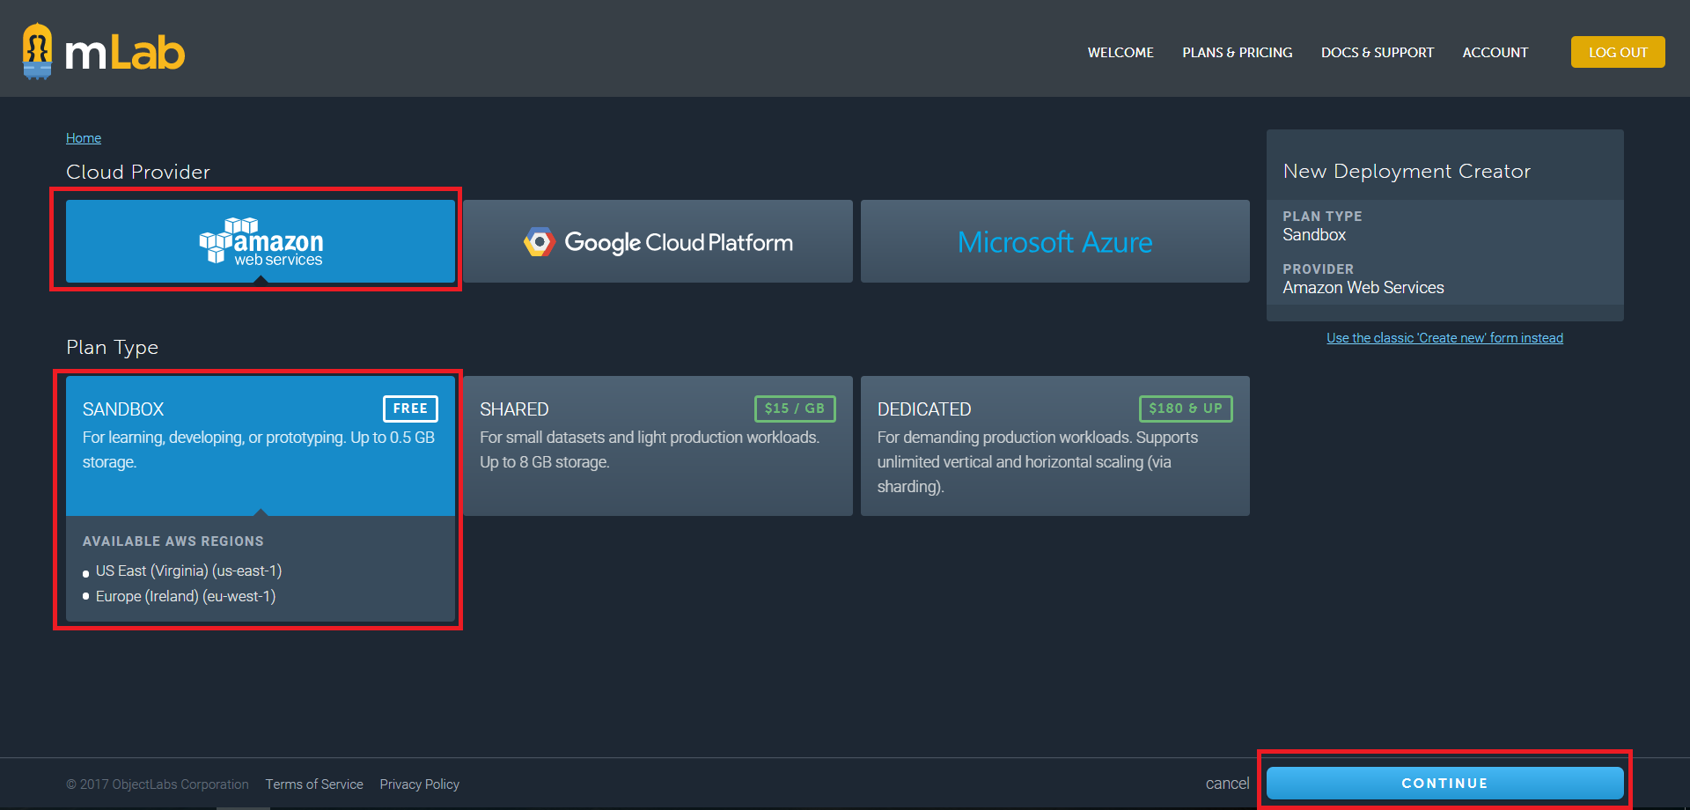
Mongo Lab – Data Base creation

Slide 14
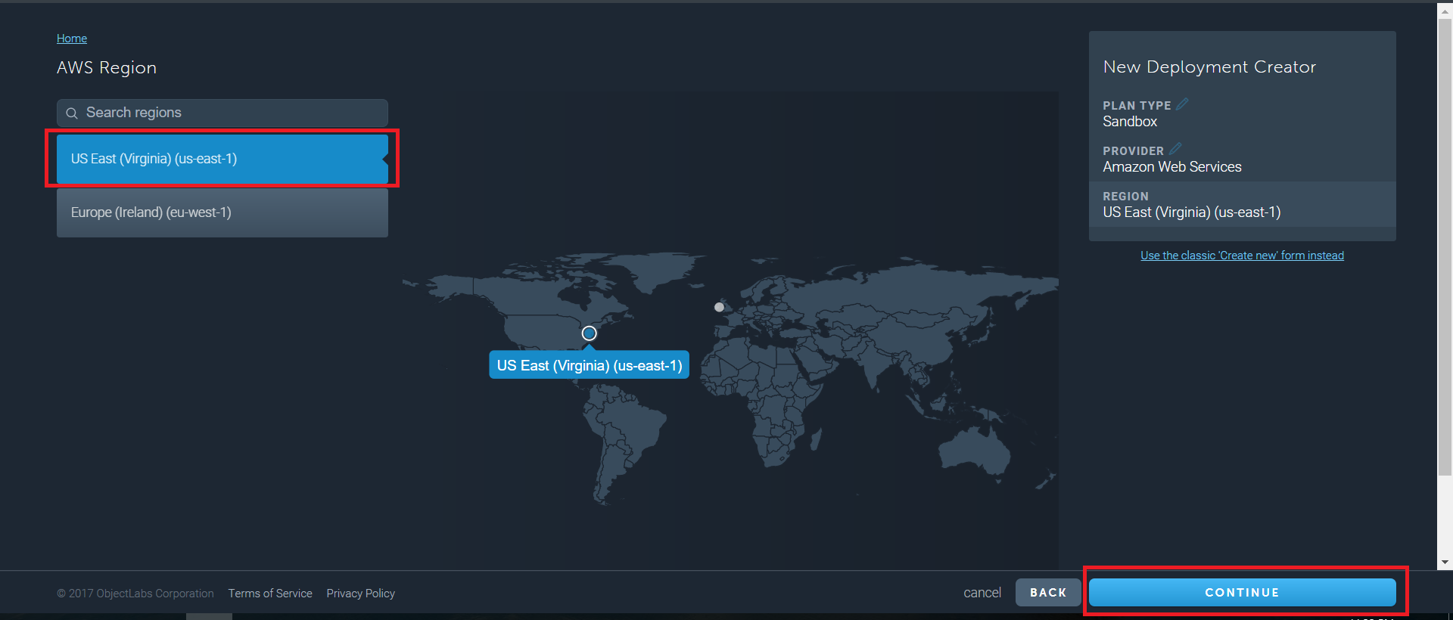
Mongo Lab – Data Base creation

Slide 15
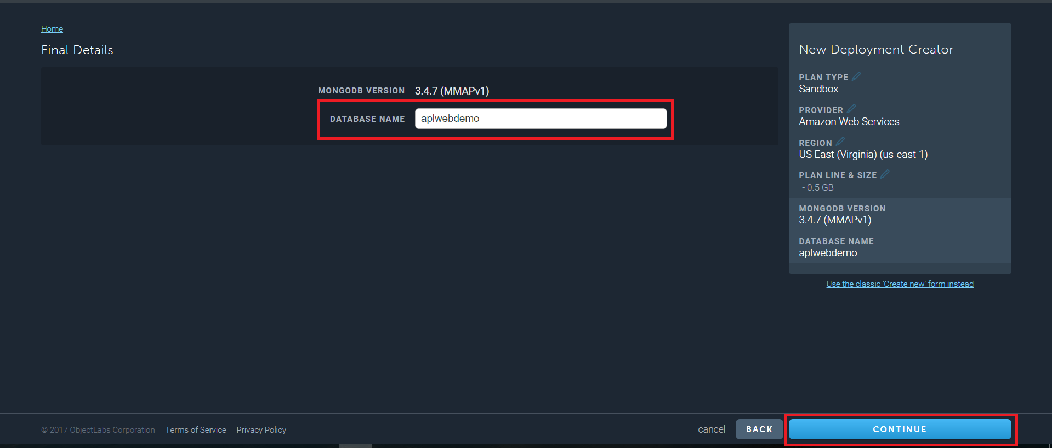
Mongo Lab – Data Base creation

Slide 16
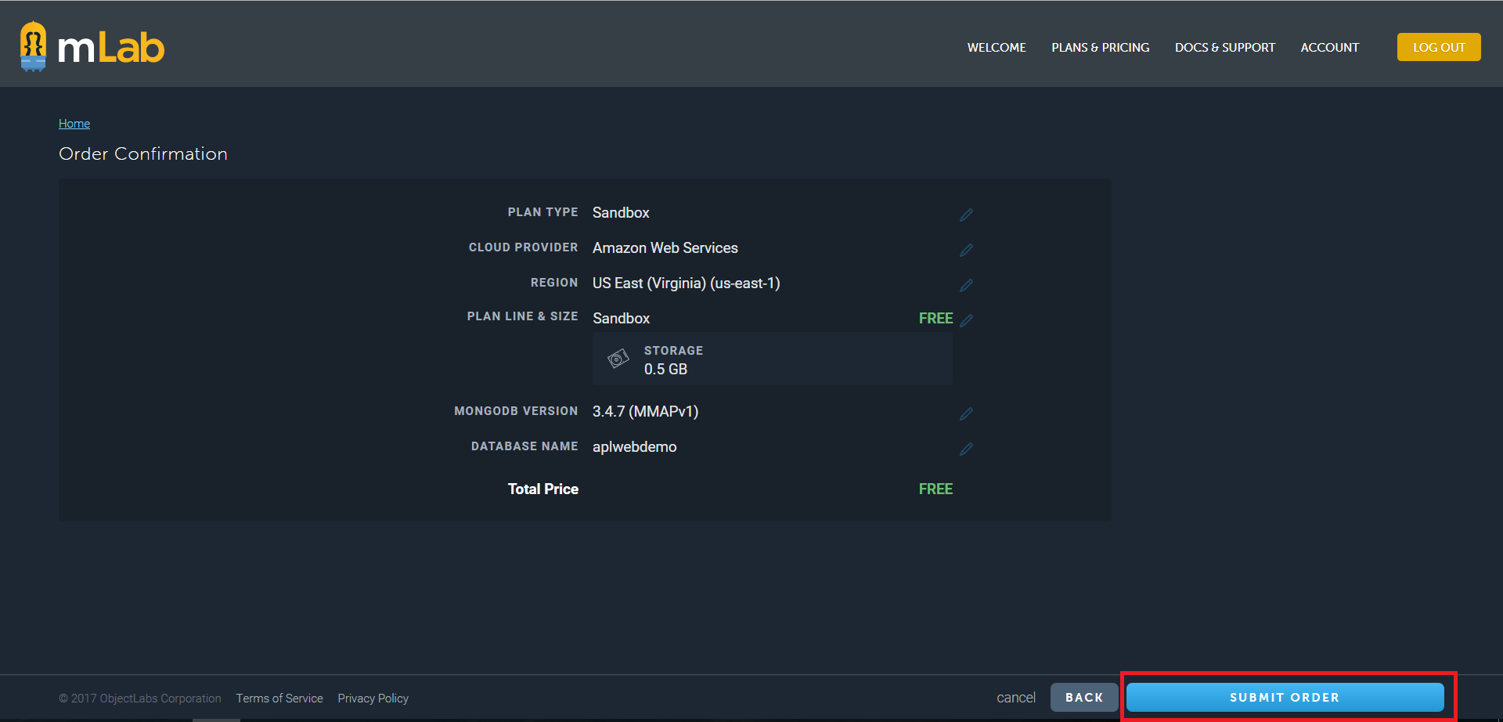
Mongo Lab – Data Base creation

Slide 17
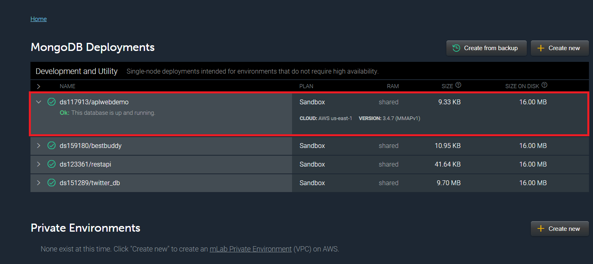
Mongo Lab – Data Base creation

Slide 18
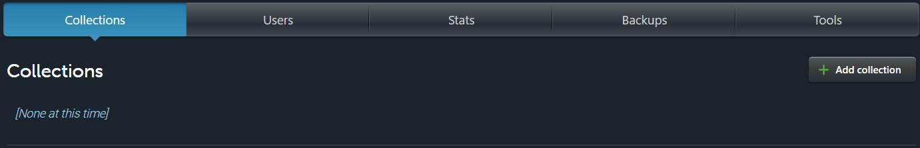
Mongo Lab – Data Base creation
The newly created database will be added to the MongoDB deployments as shown below
Click on the database name. Your database page will open

Slide 19
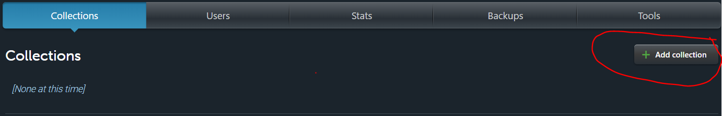
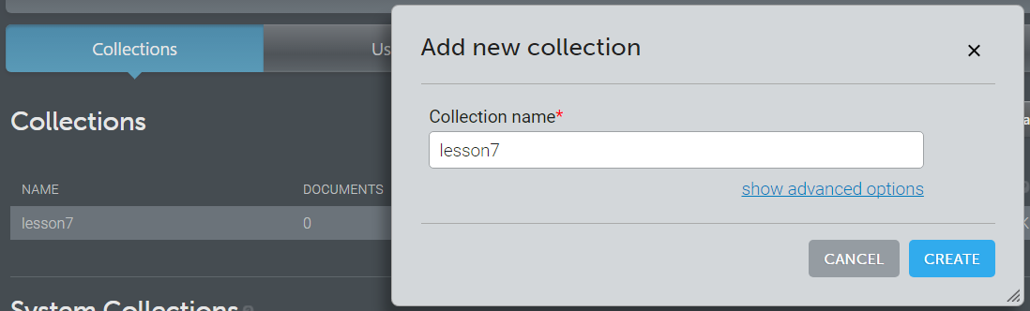
Mongo Lab – Collection creation
Click on “Add Collection” in the collections tab to created a collection
Provide a name for your collection and click on create
The collection will be displayed as shown

Slide 20
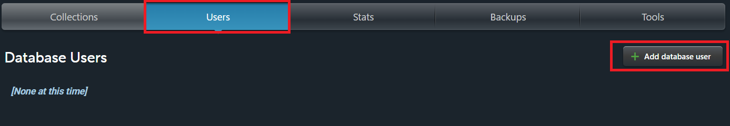
Mongo Lab – Users creation
Go to Users Tab
Click on "Add database User" to create a new user
A pop window will open
Give a username and password for your database and click on create
To give read only access you can check the Make read only option

Slide 21
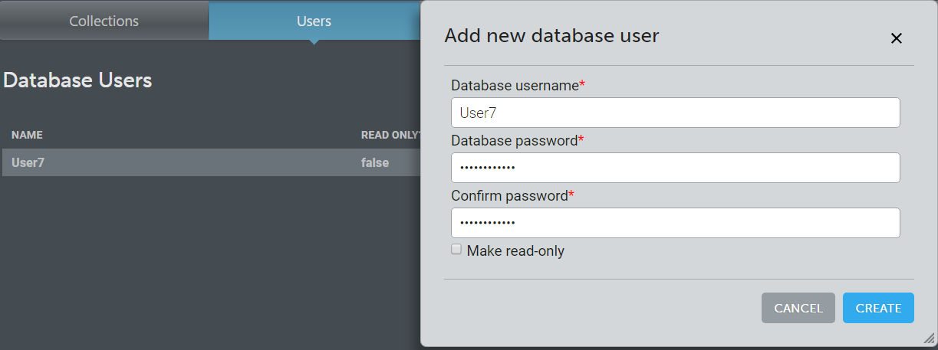
Mongo Lab – Users creation

Slide 22
Mongo Lab - Data API
http://docs.mongolab.com/data-api/
Each Mongo Lab account comes with a Data API (disabled by default) that can be used to access the databases, collections and documents belonging to that account
Each user of an account has his own API key that can be used to access the API
Users can view or reset their API keys through the management portal

Slide 23
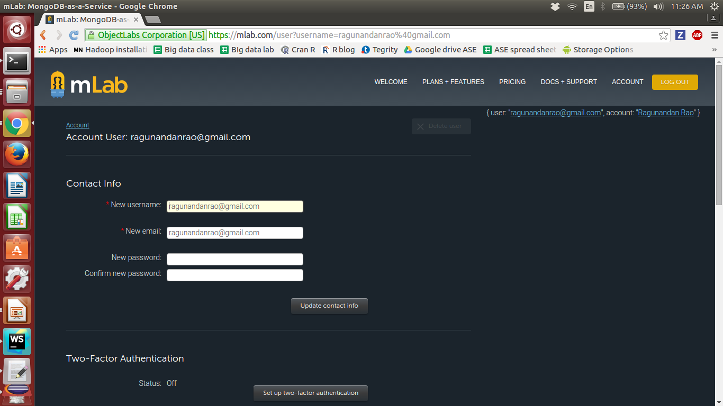
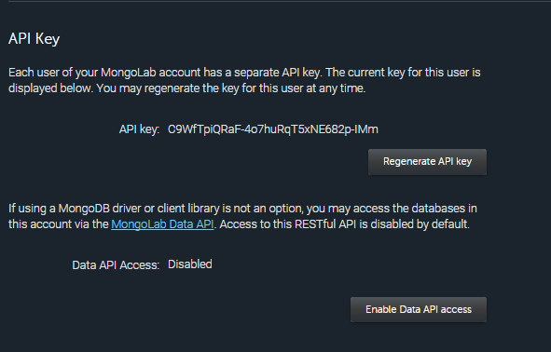
Enable Data API
Click on your user name in the upper right-hand corner to open your account user profile
If the status is showing as “Data API Access: Disabled” in the “API Key” section, click the “Enable Data API access” button

Slide 24
Data API Operations
GET: Select/Retrieve Data
Post: Insert
Put : Update
Delete: Delete

Slide 25
DATA API URL Format
https://api.mongolab.com/api/1/databases/yourDatabaseName/collections/yourCollectionName?apiKey=yourAPIKey
Base URL Path: https://api.mongolab.com/api/1
Eg:https://api.mongolab.com/api/1/databases/asedb/collections/asedb?apiKey=1iwTCrjgXRLz-tbL9nznRtZRB5K9p_Zs

